Slide 1

BCSSA
Stroke & Turn Clinic
BC Summer Swimming Association
Officials Certification Program

Slide 2
Today
Description of the Officials
The pool deck
Philosophy and Behaviour
Harassment Policy
Jurisdiction
Disqualification Process
Common Disqualifications
Freestyle Disqualifications
Backstroke Disqualifications
Breaststroke Disqualifications
Butterfly Disqualifications
IM Disqualifications
Freestyle/Medley Relay Disqualifications

Slide 3
The Role of Officials
To ensure that all swimmers have a fair chance for success while preparing for their races and during their races

Slide 4
Preparing For Their Races
There are very specific rules for warm up. Only certain approved lanes can be used for diving warm up. Failure to enforce this rule may result in serious injury. While this duty typically falls to a safety marshal, all officials must step in if they see an unsafe act.
Swimmers are entitled to a bully and harassment free environment. Again, if we note this happening we, as officials, must step in to intervene immediately. This incident may be escalated to the Meet Referee if it can not be dealt with.

Slide 5
During Their Races
To keep a race fair for all swimmers, some swimmers may be disqualified for infraction of the rules. No one likes to see a swimmer disqualified, but failure to do so may result in an unfair advantage for that swimmer over another
Disqualifying a swimmer may help fix an issue by reinforcing what the swimmer’s coach has been attempting to fix

Slide 6
The Deck Officials (aka “White Shirts”)
While dressed the same, the “White Shirts”, as we are called have many different tasks.
  Referee - They have overall charge of the meet or session and will make decisions regarding the meet including in some cases a decision not to allow a disqualification brought to them by another white shirt.
  There are 2 Referees: a Meet referee and a Session referee. The Session referee runs an event such as freestyle. They are in charge of the pool while they are on deck. The Meet referee however retains overall command of the officiating of the meet.
  Starter - They are responsible for starting the race and ensuring a fair start. In some meets they may be given additional jurisdiction. This is at the discretion of the referee.

Slide 7
More White Shirts
Head Timer - They instruct the lane timers on how to time. An example of this might be a situation in which we switch from 50 metre races to 100 metre races. Letting the timers know this will hopefully ensure they do not jump up and hit their plunger or stopwatch early. They will also coach the timers on good positioning. In some meets the head timer will assist as a turn judge.
Designated Disqualification Official (DDO) - These officials report the DQ to the swimmer’s coach.

Slide 8
Lane Timers & Recorders
Lane Timers are responsible for:
Timing the swimmer in the assigned lane from the starting signal to the ‘final touch’.
Remaining seated when not engaged in timing the finish of a race or performing other assigned duties.
Taking up a position over the finish end of the assigned lane in order to observe the finish.
When manually timing, starting the watch immediately upon seeing the flash of the starting signal.
Stopping the watch or pressing the plunger button immediately upon the swimmer completing the required distance and any part of the body touching the pad, the end wall, or crossing the imaginary vertical plane extending upward from the wall.

Slide 9
Lane Timers & Recorders
The Lane Recorder is responsible for:
Ensuring that the correct swimmer is in the assigned lane by asking “What is your name?”
Recording the Timers’ initials and their times.
Recording the time the Head Timer gives them, if necessary, and circling it with the initials “HT” beside it.
Determining whether the correct swimmers are participating in a relay event by asking “What is your name?” to each swimmer.

Slide 10
Stroke & Turn Officials
Stroke - They typically watch the stroke in the lanes closest to them. In an eight-lane pool this would be the four closest lanes. In a six-lane pool this would be the three closest lanes. They are also responsible for pulling the recall rope when asked to by the referee.
Turn – Typically, they are responsible from the last stroke into the wall, through the turn and the first stroke out from the wall. The referee may adjust the jurisdictions at the beginning of a meet.

Slide 11

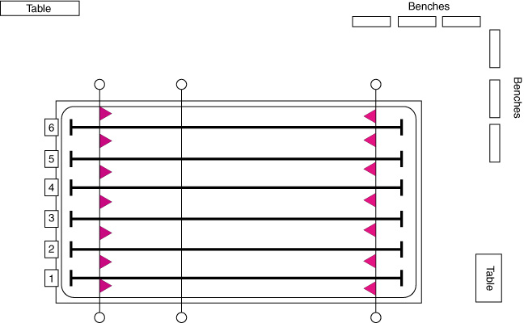
The Pool Deck
Backstroke flags 5m
Recall rope 15m
15m cones

Slide 12
Meet the Officials

Slide 13
Meet the Officials
Referee

Slide 14
Meet the Officials
Referee
Starter

Slide 15
Meet the Officials
DDO
Referee
Starter

Slide 16
Meet the Officials
DDO
Head Timer
Referee
Starter

Slide 17
Meet the Officials
DDO
Head Timer
Referee
Timers
Starter

Slide 18
Meet the Officials
DDO
Head Timer
Referee
Stroke Judge
Timers
Starter
Stroke Judge

Slide 19
Meet the Officials
DDO
Head Timer
Referee
Stroke Judge
Timers
Turn Judges
Starter
Stroke Judge

Slide 20
Meet the Officials
DDO
Head Timer
Referee
Stroke Judge
Timers
Turn Judges
Clerk
Starter
Stroke Judge

Slide 21
Meet the Officials
Marshalling
DDO
Head Timer
Referee
Stroke Judge
Timers
Turn Judges
Clerk
Starter
Stroke Judge

Slide 22
Meet the Officials
Chief Judge Electronics
Marshalling
DDO
Head Timer
Referee
Stroke Judge
Timers
Turn Judges
Clerk
Starter
Stroke Judge

Slide 23
Meet the Officials
Chief Judge Electronics
CMR
Marshalling
DDO
Head Timer
Referee
Stroke Judge
Timers
Turn Judges
Clerk
Starter
Stroke Judge

Slide 24
Meet the Officials
Chief Judge Electronics
CMR
Marshalling
DDO
Head Timer
Referee
Stroke Judge
  Approximately 30 officials on deck to run a meet.
Timers
Turn Judges
Clerk
Starter
Stroke Judge

Slide 25
Officials - Expectations
Dress Code
      White shirt and wristwatch
      Professional looking shorts or pants
      Comfortable shoes that conform to the pool rules
      Expect to get wet!!
      Sunglasses, sunscreen and hats outdoors
Arrival Time
      At the officials meeting (usually in Meet Pkg.)
      If you are 1st shift, arrive 10-15 min prior to the planned start time.
      If you are 2nd or 3rd shift, arrive at your post to relieve the current official, 5 minutes before.

Slide 26
Officials - Ethics
Have a positive attitude.
Accept an assignment only if you intend to honour the commitment.
Accept the assignment you have been given.
Don’t leave your post.
Complete the session.
Be impartial (cheering shouldn’t be done).
Be inconspicuous.
A Referee’s decision is final (don’t be offended).
Remain cool and professional at all times.
Be fair to all.
Be friendly, but don’t distract swimmers mentally preparing for a race.
Know the rules thoroughly.

Slide 27
Philosophy and Behaviour
Swim Meets are for swimmers
Be as inconspicuous as possible.
      Avoid being militant or officious
      Lead by example
You will earn the respect of swimmers and coaches by being responsible, competent and knowledgeable.
You must continue to keep up with rule changes (attend a clinic each year to keep up to date).

Slide 28
Philosophy and Behaviour
Rules and guidelines exist to regulate fair play, and to prevent the unfair advantage of one competitor over the other.
You are there to ensure fairness; no unfair advantage.
You are also there to provide learning and instruction to swimmers (the errors you point out are the areas the coach will focus on in future practices).
Always give the benefit of the doubt to the swimmer.

Slide 29
Philosophy & Behaviour
Pay attention, do your job (the swimmers take it seriously, so should you).
Ensure you are properly situated with no obstruction (e.g.: turn at edge of pool).
Be aware of stroke variations that are legal, as well as those that are illegal.
Always use common sense.
Be reasonable and certain of what you are doing.
If unsure, always consult the referee or other officials.

Slide 30
Philosophy & Behaviour
Arrive before the meet starts in time for the Officials meeting.
Before the meet, the Meet Referee will establish the procedures to be followed for the meet.
Have your rulebook with you.
If you are going to make a DQ, ensure your position is covered.
  STROKE: Starter & Referee
  TURN: Increased coverage by turn judges

Slide 31
Philosophy & Behaviour
Rotations occur at the end of each page in the swim program, unless otherwise specified – be alert and prompt in rotations.
When responsible for the recall rope, ensure you know how to release it.
Take advantage of conflict resolution and harassment clinics when they are held in your region.
Be familiar with the Harassment Policy.

Slide 32
BCSSA Harassment Policy
There will be no tolerance of harassment within the BC Summer Swimming Association.
The BC Summer Swimming Association is committed to providing a sport and work environment in which all individuals are treated with respect and dignity.
Each individual has the right to participate and work in an environment which promotes equal opportunities and prohibits discriminatory practices.

Slide 33
Jurisdiction – Stroke Judge
Stroke
Judge
Starter
Stroke
Judge
Referee

Slide 34
Jurisdiction – Turn Judge
Stroke
Judge
Starter
Turn
Judge
Turn
Judge
Turn
Judge
Stroke
Judge
Referee

Slide 35
Disqualifications
Don’t be Obvious
Stroke
Judge
Starter
Turn
Judge
Turn
Judge
Turn
Judge
Stroke
Judge
Referee

Slide 36
Disqualifications
Inform the Referee / Starter
Stroke
Judge
Starter
Turn
Judge
Turn
Judge
Turn
Judge
Stroke
Judge
Referee

Slide 37
Disqualifications
Stroke
Judge
Starter
Turn
Judge
Turn
Judge
Turn
Judge
15 min.
Stroke
Judge
Referee

Slide 38
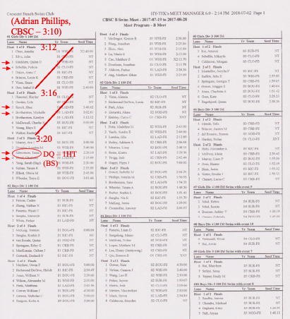
Heat Sheet Notation
Write your name and club at the start of your shift
Write your jurisdiction down at the start and as you change position
Cross out events/heats as they are completed
If you observe a DQ, circle the lane number , note the time and very briefly describe the infraction

Slide 39
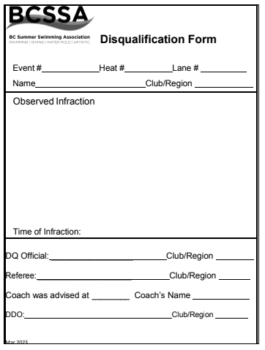
The DQ Slip – How do I fill it out?
Check your information against the heat sheet
Reason for DQ
  Use “common wordings” but write what you saw
Print neatly – especially your name and club
Take slip to referee*
Notes:
*In some cases, jurisdiction over who receives the DQ slips may be given by the Session Ref to another person (ie. Starter or Back-Up/DQ Ref)

Slide 40
Process for Disqualifications
Don’t leave your position early or otherwise signal a DQ.
Advise Session Ref which swimmer is being DQ’d and for what reason.
After Referee has signed off the DQ, Designated Disqualification Official (DDO) will advise the coach of the DQ’d swimmer and for what reason.
Take your time to explain the reason for the DQ to the referee. Don’t feel rushed or mistakes could be made.

Slide 41
Disqualifications
Be consistent in all competitions
Treat all competitors alike
Watch for infractions of the rules whether they give an advantage or not
Never coach or warn a swimmer
Make your presence felt, but not obvious
Be sure you saw what you think you saw
NO DQ’s for 25m events (6 & Under)

Slide 42
Disqualifications
Be prepared to explain your observation to the Referee or to a Jury of Appeal.
If you make a mistake, it’s ok. It’s part of the learning experience.
Never discuss or argue about a DQ with a swimmer, coach, or parent. Refer them to their coach, who can then talk to the Session Ref.
Don’t be afraid to ask the opinion of another official as to whether what you observed is a disqualification or not.

Slide 43
Stroke and Turn Judges
One Stroke Judge shall operate on each side of the pool, walking and observing swimmers, giving each lane equal observation time, in the nearest half of the pool.
Stroke Judge may observe the swimmers touch in the nearest half of the pool for each turn and finish, if given jurisdiction.
A Turn Judge shall observe the swimmer during the turn, giving each swimmer equal observation time.
  To provide equal observation time, the judge may move to each lane to observe the turn as long as they have enough time to do the same for the swimmer in the next lane. Otherwise, they should straddle the lane to observe both swimmers at the same time.
A Relay Take-Over Judge shall observe the ‘touch-out’ and ‘take off’ of relay team members.

Slide 44
All Strokes - Allowed
Standing on the bottom.
Resting on the float lines / side of pool.
Surfacing in the wrong lane (there must be no interference and must finish in the proper lane).
During the turn, from the touch until the swimmer leaves the wall is a “free zone”, (e.g.: goggles can be adjusted w/o DQ.)
Disabled swimmer deviations per Referee (no advantage over other swimmers).

Slide 45
All Strokes – Not Allowed
Illegal swimsuit (see rule book)
The swimmer shall not leave the water prior to finishing the race.
  This is not a DQ, but a DNF (Did Not Finish)
The swimmer shall not advance by:
  “Walking on bottom in the direction of the finish”
  “Pulling on the lane rope/side of pool in the direction of the finish”
  “Springing from the bottom in the direction of the finish”
*The phrases in quotes are the suggested wording used on DQ slips

Slide 46

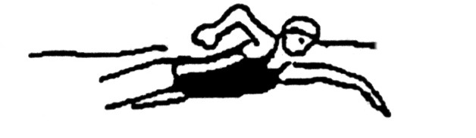
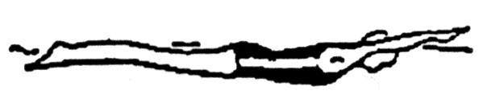
Freestyle
Any stroke or combination in any sequence.
  Front crawl is most common but any stroke is legal
At each turn and at the finish, some part of the swimmer’s body must touch the end wall or cross the imaginary vertical plane.
On the start and at the turn, the head must break the surface before the 15m mark (marked with cones/lane ropes).

Slide 47
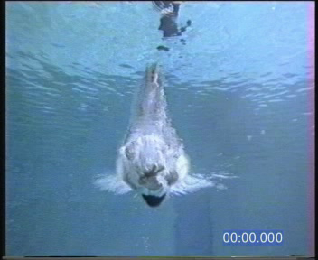
Freestyle Video

Slide 48
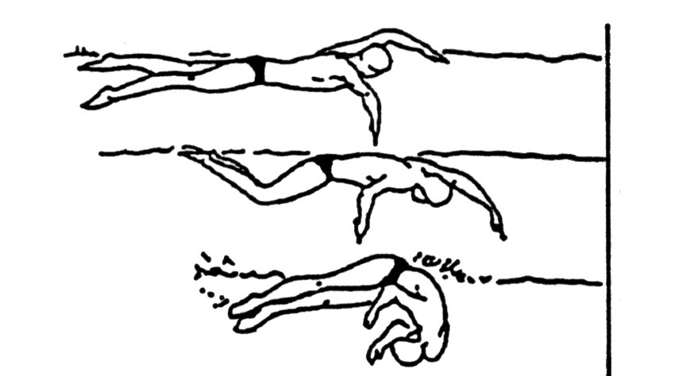
Freestyle Turn
Did the swimmer touch the wall with any part of their body?
If they missed touching, they can return to touch with no DQ; same for the freestyle relay if they left early.

Slide 49
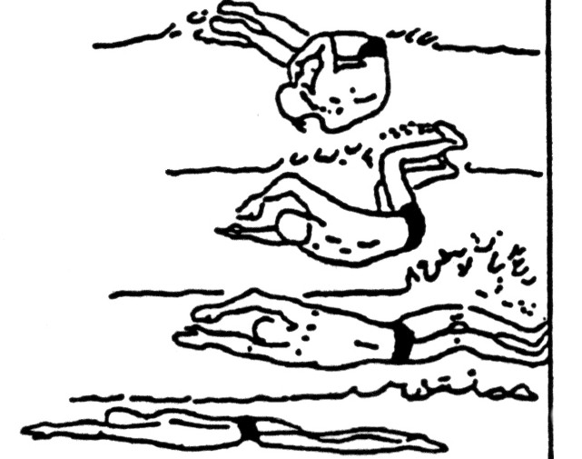
Freestyle Turn
Did the swimmer touch the wall?

Slide 50
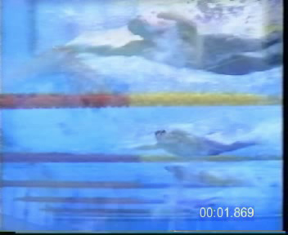
Freestyle Turn Video

Slide 51
Freestyle – DQ Wording
The following is the suggested, but not the only wording for disqualifications (write more rather than less):
  “Failure to touch on the turn at 25m (50m, 75m)”
  “Failure to surface by 15m after the start (or turn at 25m, 50m, 75m)”

Slide 52
Backstroke
Any stroke or combination may be used as long as it is swum on the back.
Following the start and after the turn, the head must break the surface before the 15 metre mark.
They must finish on their back (including the backstroke portion of the relays).

Slide 53
Backstroke
The normal position on the back can include a roll movement of the body up to, but not past 90 degrees from horizontal as determined by the line of the shoulders.

Slide 54
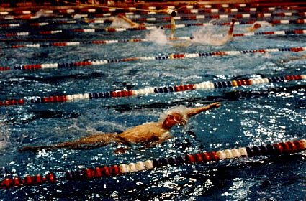
Backstroke
Rolling beyond the vertical (Infraction during stroke, but permitted on the turn.)

Slide 55
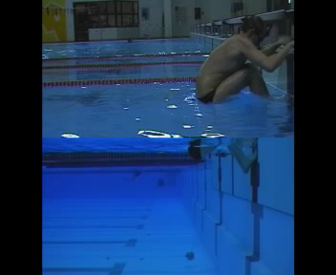
Backstroke Video (Video 3)

Slide 56
Backstroke Turn
Executing a turn is a continuous motion, meaning a uniform, unbroken motion with no pauses.
After the upper shoulder rotates beyond the vertical toward the breast, a continuous single arm pull or a continuous double arm pull may be used to execute the turn – not two separate arm pulls.
A swimmer can scull back to the wall to complete the turn if the wall is missed.
Attention must be focused on the upper body of the swimmer.

Slide 57
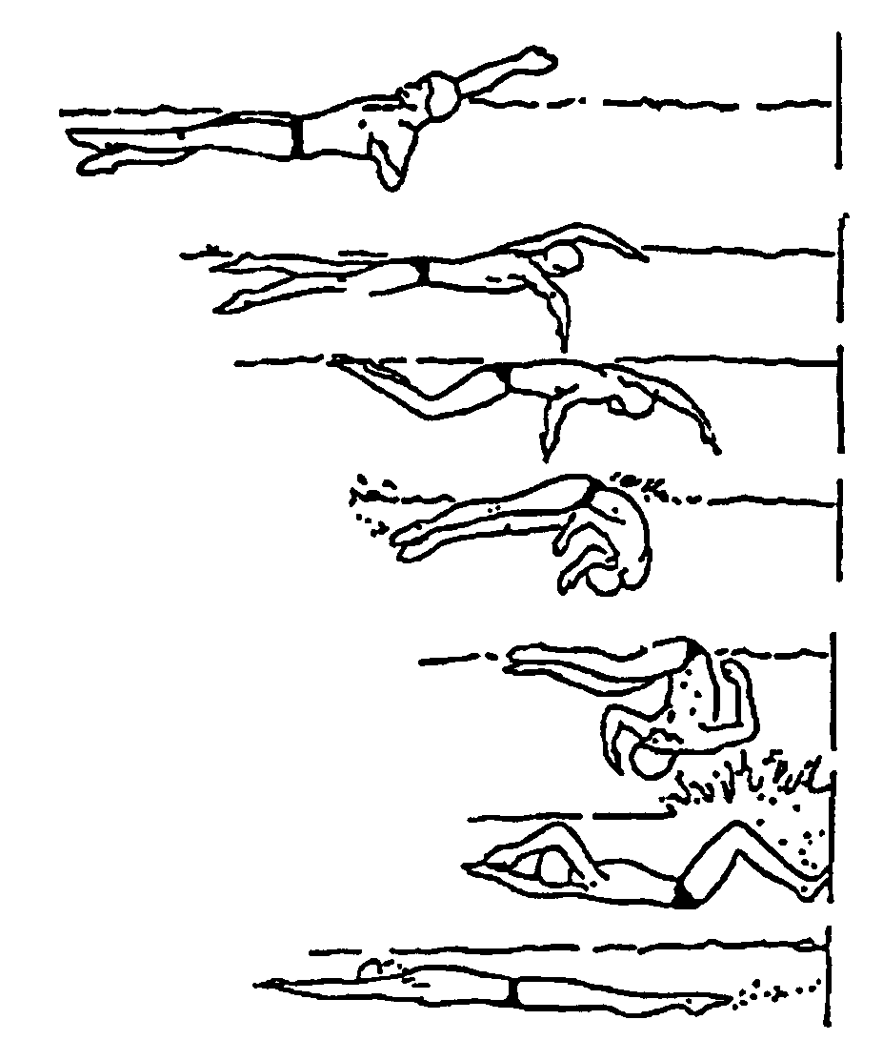
Backstroke Turn

Slide 58
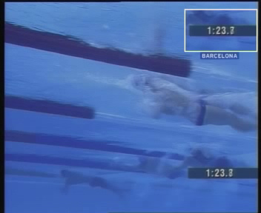
Backstroke Turn Video (Video 4)

Slide 59
Backstroke – DQ Wording
The following is the suggested, but not the only wording for disqualifications:
  “failure to touch on the turn at 25m (50m, 75m)”
  “non-continuous turn at 25m (50m, 75m).”
  “failure to remain on back during race (or at finish)”
  “failure to surface by 15 m after the start (or turn at 25m, 50m, 75m)”
  “not on back when feet left the wall at 25m (50m, 75m)”

Slide 60
Breaststroke
Each cycle must have one arm stroke, one leg kick and the head must break the surface of the water.
The body must be kept on the breast.
Arm movements must be simultaneous and in the same horizontal plane and must not extend beyond the hips.
Leg movements must be simultaneous and in the same horizontal plane.
The toes must not turn inward in the backward movement of the kick (or it is a scissor kick).

Slide 61
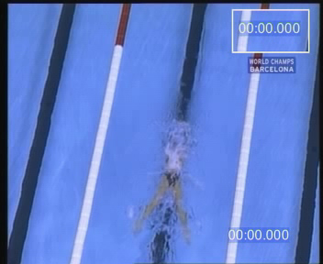
Breaststroke – Slow (Video 7)

Slide 62
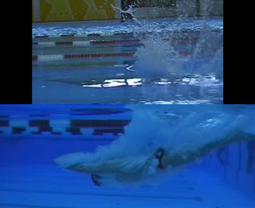
Breaststroke – Over/Under
(Video 8)

Slide 63
Breaststroke Turn
Jurisdiction: From the beginning of the last arm stroke “in” to the completion of the second arm pull “out”.
Must touch with both hands simultaneously (does not have to be at the same level).
Hands cannot be stacked one on top of the other (Thumbs touch or overlapping of fingers only okay).
May turn in any manner as long as the prescribed form is attained before the start of the first arm pull.
From the beginning of the first armstroke after the start and after each turn, the body shall be kept on the breast.

Slide 64
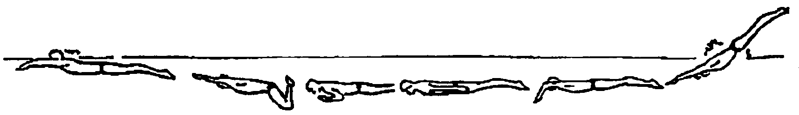
Breaststroke Start (and Turn)
The hands may extend beyond the hips during the first stroke after the start and each turn; such extension at any other time is a DQ.
A single dolphin kick is allowed at the start and after each turn at any time prior to the first breaststroke kick.

Slide 65

Breaststroke Turn (Video 9)

Slide 66
Breaststroke – DQ Wording
The following is the preferred, but not only wording for DQs:
  “non-simultaneous touch at 25m (50m, finish)” (include which hand touched first)
  “non-simultaneous touch at 25m (50m, finish) with one hand on top of the other”
  “one hand touch as 25m (50m, 75m, finish)” (include which hand)
  “scissor kick” or “flutter kick”
  “more than 1 dolphin kick at start (or turn at 25m, 50m or 75m)”

Slide 67
Breaststroke – DQ Wording (cont.)
  “alternating arm movements”
  “asymmetric arm pull”
  “arm pull past hips – other than at start or turn”
  “failure of head to surface during each stroke” – except first stroke at start and turn.
  “failure of head to surface before the hands turn inward at the widest part of the second stroke on start (or turn at 25m, 50m, 75m)”

Slide 68
Butterfly
From the beginning of the first arm stroke after the start and after each turn, the swimmer’s body shall remain on the breast.
The swimmer shall bring both arms forward together over the water, or at least breaking the surface and backward simultaneously throughout the race.
There is no limit to the number of legal kicks.
Legs must not alternate with each other, but can be offset.
Kick may be dolphin or breaststroke (not scissor) and may change back and forth without penalty.
Must break the surface before 15m on start and turns.

Slide 69
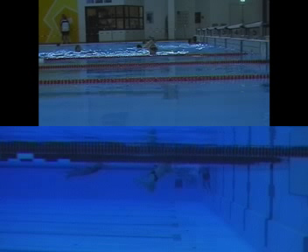
Butterfly Video (Video 5)

Slide 70
Butterfly - Turn
Must not recover arms under the water to touch.
Touch must be with both hands simultaneously.
Hands cannot be stacked one on top of the other (Thumbs touch or overlapping of fingers only okay).
Underwater kicking on the side is allowed BEFORE the first arm pull after the turn.

Slide 71
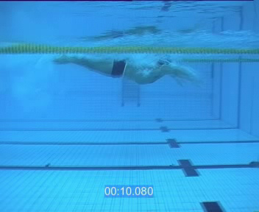
Butterfly Turn (Video 6)

Slide 72
Butterfly – DQ Wording
The following is the preferred, but not only wording for disqualifications:
  “non-simultaneous touch at 25m (50m, finish)” (include which hand touched first)
  “non-simultaneous touch at 25m (50m, finish) with one hand on top of the other”
  “one hand touch at 25m (50m, 75m, finish)” (include which hand touched)
  “Flutter kick”
  “Scissor kick”
  “Underwater arm recovery”
  “Non-simultaneous arm pull”
  “Failure to surface by 15m after the start (or turn at 25m, 50m, 75m) in the butterfly”

Slide 73
Medley Races
Individual Medley Medley Relay
Butterfly (Fly) Backstroke (Back)
Backstroke (Back) Breaststroke (Breast)
Breaststroke (Breast) Butterfly (Fly)
Freestyle (Free) Freestyle (Free)
FBBF! BBFF!
Note: In medley races, “freestyle” includes asymmetrical or no arm movements and remaining primarily on the breast. They also shall not exhibit a backstroke arm pull.

Slide 74
Medley Races
Swimmers must abide by the rules of the individual stroke concerned.
IM only: When changing from one stroke leg to the next, swimmers may turn in any manner once a legal touch has been made, but they must attain the form of the stroke of the next leg of the race in accordance with the rule for that stroke.
During the Backstroke phase, the final touch must be made while on the back

Slide 75
Relays/IM – DQ Wording
The following is the preferred but not only wording for disqualifications (write more rather than less):
“strokes swum in wrong order”
“roll more than 90 degrees before touching on the change over from back to breast” – only applies to IM
“swimmer # ___ left the blocks before swimmer # ___ touched” – only applies to relays
Note that swimmers can return without penalty, touch and start again if they left early – for both freestyle and medley relays

Slide 76
Thank-You for Attending
If you have any questions please ask me
My email address is:
Approved by the BCSSA Rules & Regulations Committee

